Slide 1


Slide 2


TODAY’S AGENDA
Introduction To JQuery
Advantages Of JQuery
Downloading JQuery
Examples

Slide 3
WHAT IS JQUERY?
jQuery is a precoded JavaScript library.
In other words , it is a collection of predefined JavaScript functions which makes it easier for us to use JavaScript on our website.

Slide 4
WHAT IS JQUERY USED FOR?
jQuery is primarily used for:
DOM Tree Traversal
DOM Tree Manipulation
CSS Effects
Ajax

Slide 5
ADVANTAGES OF JQUERY
Simplifies common JavaScript tasks —
jQuery considerably simplifies the common JavaScript tasks. For example it allow us to traverse the DOM tree of an HTML document's structure in an efficient manner.
To understand this benefit answer the question given on next slide

Slide 6
ADVANTAGES OF JQUERY
Can you write a JS function called changeText() which whenever called changes the text of any button whose class attribute is highlight to Next ?

Slide 7
ADVANTAGES OF JQUERY
function changeText(){
let inputs=document.getElementsByClassName("highlight");
for(let i=0;i<inputs.length;i++)
if(inputs[i].getAttribute("type")==="button"){
inputs[i].setAttribute("value","Next");
}
}
As we can observe the body of the function changeText( ) is around 5
lines , but if the same code is written using jQuery , can you imagine
number of lines it will take ?
Answer: Just 1 line !!

Slide 8
ADVANTAGES OF JQUERY
function changeText(){
$( "button.highlight" ).html( "Next" ) ;
}

Slide 9
ADVANTAGES OF JQUERY
Easy to use —
jQuery is very easy to use. Anybody with the basic working knowledge of HTML, CSS and JavaScript can start development with jQuery.
Compatible with browsers —
jQuery is created with modern browsers in mind and it is compatible with all major modern browsers such as Mozilla Firefox, Google Chrome, Safari, Internet Explorer, and Opera.

Slide 10
ADVANTAGES OF JQUERY
Absolutely Free —
And the best part is, it is completely free to download and use.

Slide 11
HOW TO INSTALL JQUERY
There are two ways to install jQuery :
Call direct from a CDN
a) Faster Download.
b) Might have already been cached.
Download your own copy
a) Works with no internet connection.

Slide 12
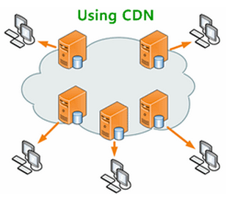
WHAT IS A CDN?
CDN stands for Content Delivery Network and is a system of distributed servers (network) that deliver webpages and other web content to a user.

Slide 13
GETTING JQUERY FROM CDN
To get jQuery from a CDN just mention the URL of the CDN in <script> tag.
From Google CDN
<script src=“http://ajax/googleapis.com/ajax/libs/jquery/3.4.1/jquery.min.js’’></script>
From Microsoft CDN
<script src=http://ajax.aspnetcdn.com/ajax/jQuery/jquery-3.4.1.min.js></script>

Slide 14
EXAMPLE
<html>
<head>
<title>Getting Jquery From Google</title>
<script
src=“https://ajax.googleapis.com/ajax/libs/jquery/3.4.1/jquery.min.js">
</script>
<script>
// your code goes here
</script>
</head>
<body>
..
</body>
</html>

Slide 15
DOWNLOADING JQUERY
We can download it from www.jquery.com
There are two versions :
“Production” for our live website , because it has been minified and compressed to take up the least amount of space.
“Development” for testing and development. It hasn’t been minified or compressed, so we can read the code in-case we want to know how jquery works.

Slide 16
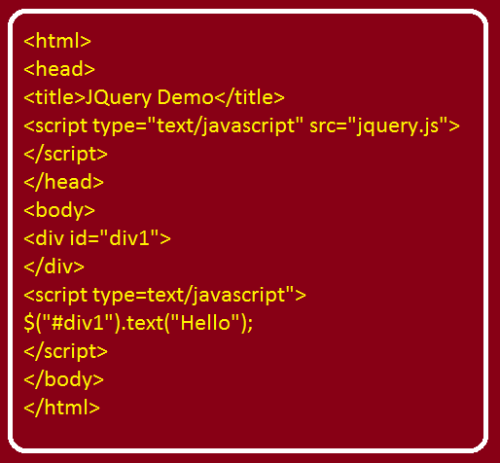
FIRST EXAMPLE

Slide 17
THE READY EVENT
In jQuery there is a special event called ready belonging to document object which allows us to assign some code and the browser will execute this code as soon as the loading the page is over.
So in this way we can remove jQuery code from body tag and put it in head tag

Slide 18
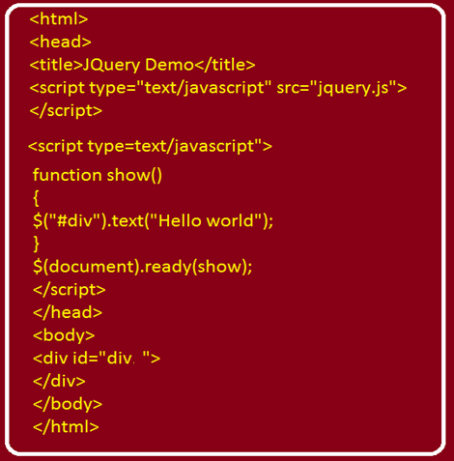
EXAMPLE

Slide 19
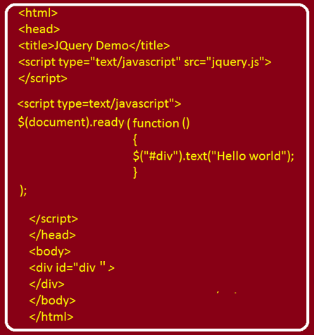
ANONYMOUS FUNCTION WITH READY EVENT

Slide 20
APPLYING CSS
In jQuery we have a function called css( ) which is used to change CSS properties of HTML elements.
For ex: to change font color - >
$(“#div1”).text(“Hello World”);
$(“#div1”).css(“color”,”red”);

Slide 21
CHAINING METHODS
jQuery allows us to chain methods i.e. we can call second method in continuation with the first method and this proves to be very handy way of writing the code.
For ex: to set the font and change it’s color
$(“#div1”).text(“Hello World”).css(“color”,”red”);

Slide 22
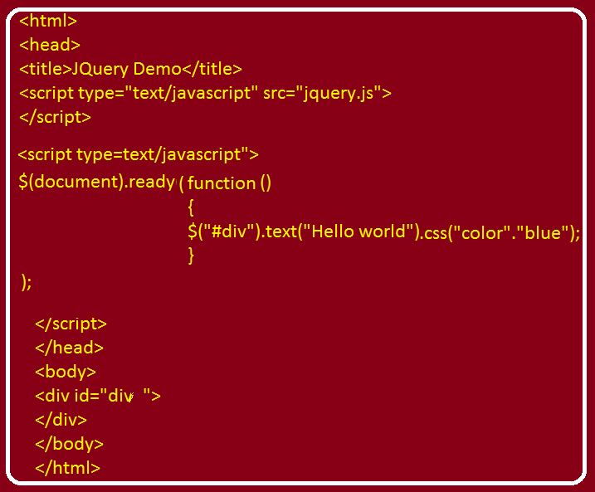
EXAMPLE

